Slide 1
Token generate and authentication

Slide 2
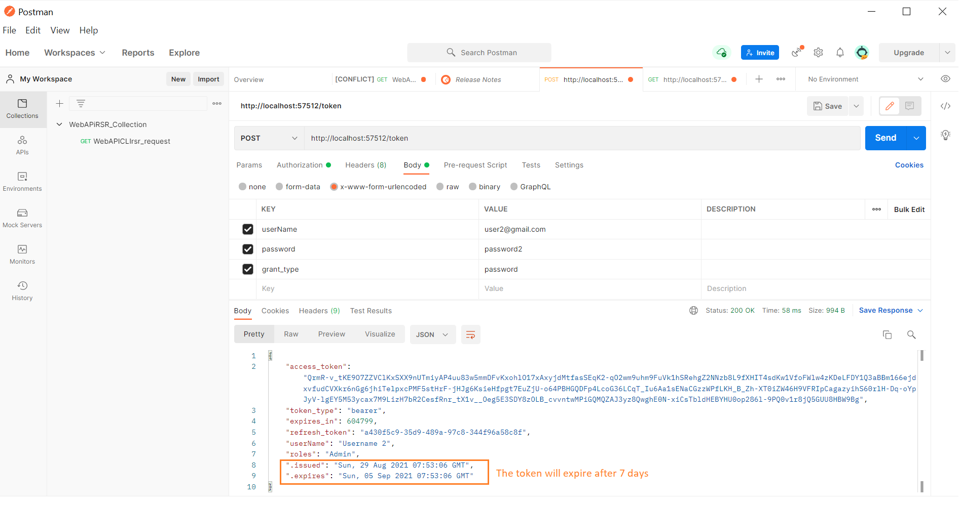
Generate the API Token

Slide 3
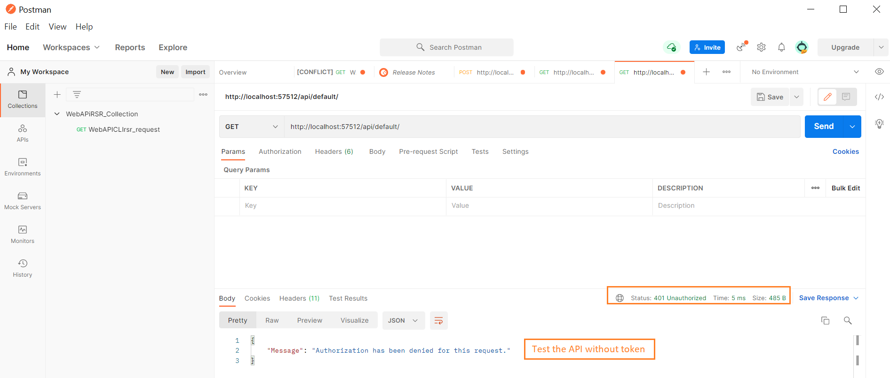
API Without Token

Slide 4
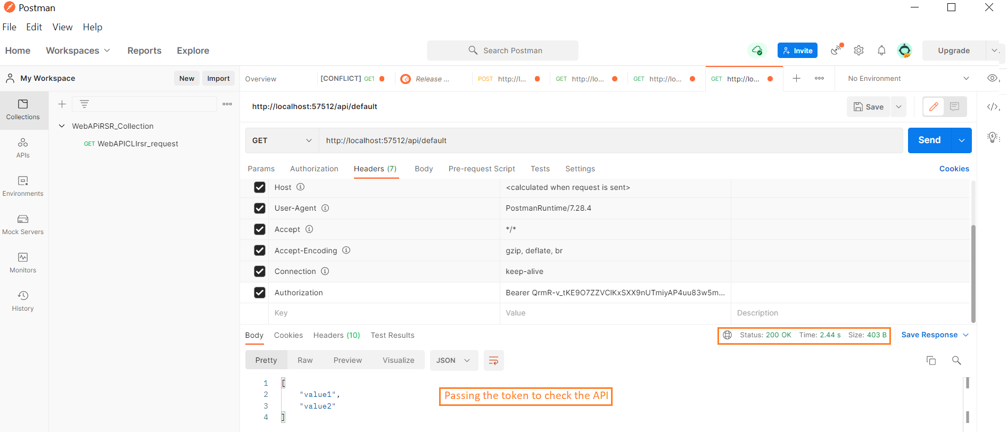
API With Token

